Slide 1
Data Analytics Neural Networks using R
Jeffrey Strickland, Ph.D., CMSP, ASEP
CEO Humalytica Analytics

Slide 2
Artificial Neural Networks (AAN)
In computer science and related fields, artificial neural networks (ANNs) are computational models inspired by an animal’s central nervous systems (in particular the brain) which is capable of machine learning as well as pattern recognition.
Artificial neural networks are generally presented as systems of interconnected “neurons” which can compute values from inputs.
Like other machine learning methods - systems that learn from data - neural networks have been used to solve a wide variety of tasks that are hard to solve using ordinary rule-based programming, including computer vision and speech recognition.

Slide 3
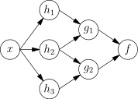
Network Function
An ANN is typically defined by three types of parameters:
The interconnection pattern between the different layers of neurons
The learning process for updating the weights of the interconnections
The activation function that converts a neuron’s weighted input to its output activation

Slide 4
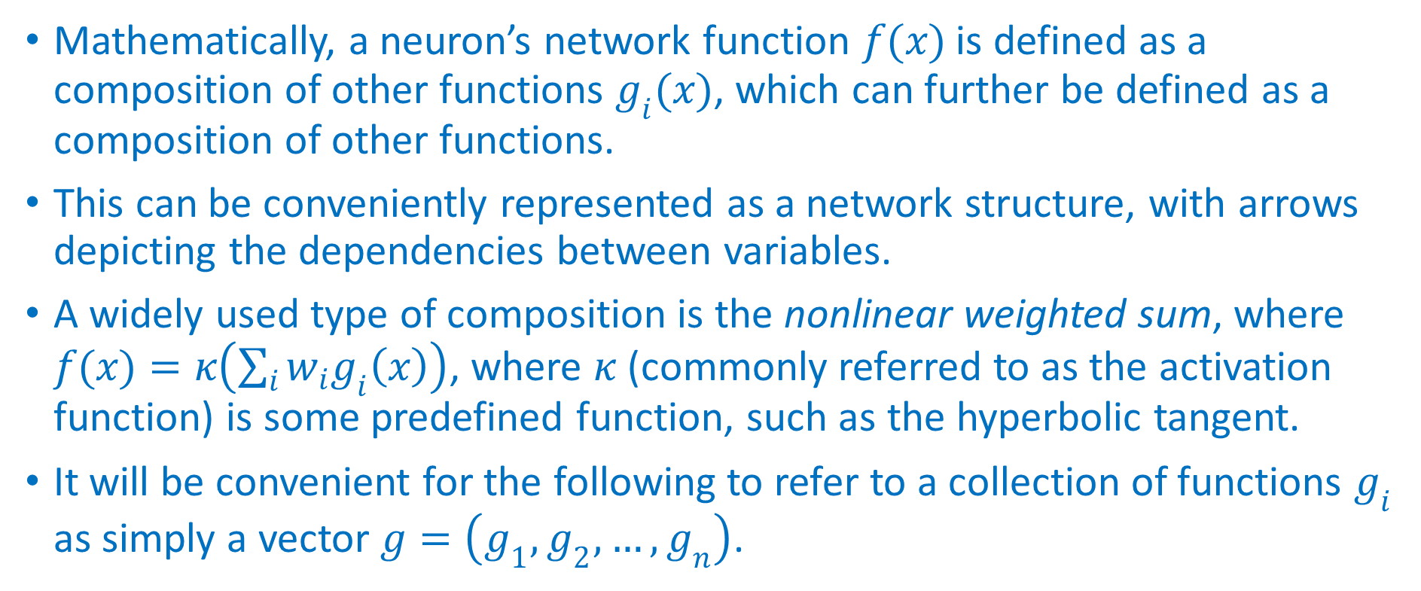
Network Function
Mathematically, a neuron’s network function $f(x)$ is defined as a composition of other functions $g_{i}(x)$, which can further be defined as a composition of other functions.
This can be conveniently represented as a network structure, with arrows depicting the dependencies between variables.
A widely used type of composition is the nonlinear weighted sum, where $f(x)=κ\left(\sum_{i}{w_{i}g_{i}\left(x\right)}\right)$, where $κ$ (commonly referred to as the activation function) is some predefined function, such as the hyperbolic tangent.
It will be convenient for the following to refer to a collection of functions $g_{i}$ as simply a vector $g=\left(g_{1},g_{2},…,g_{n}\right)$.

Slide 5
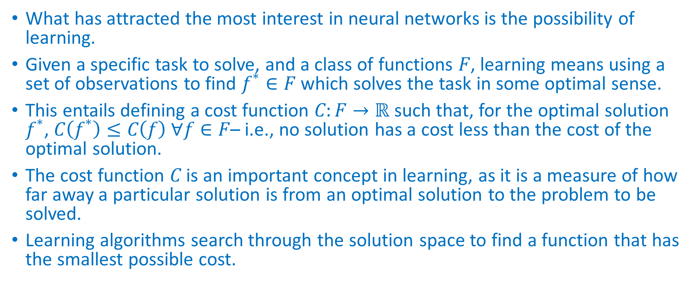
Learning
What has attracted the most interest in neural networks is the possibility of learning.
Given a specific task to solve, and a class of functions $F$, learning means using a set of observations to find $f^{∗}∈F$ which solves the task in some optimal sense.
This entails defining a cost function $C:F→ℝ$ such that, for the optimal solution $f^{∗}$, $C\left(f^{∗}\right)≤C\left(f\right) ∀f∈F$– i.e., no solution has a cost less than the cost of the optimal solution.
The cost function $C$ is an important concept in learning, as it is a measure of how far away a particular solution is from an optimal solution to the problem to be solved.
Learning algorithms search through the solution space to find a function that has the smallest possible cost.

Slide 6
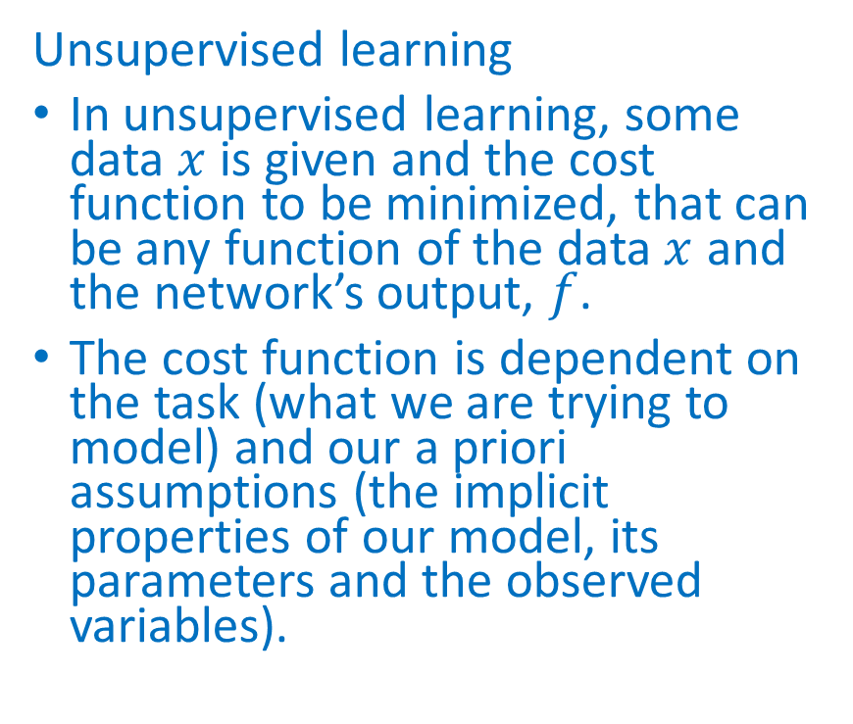
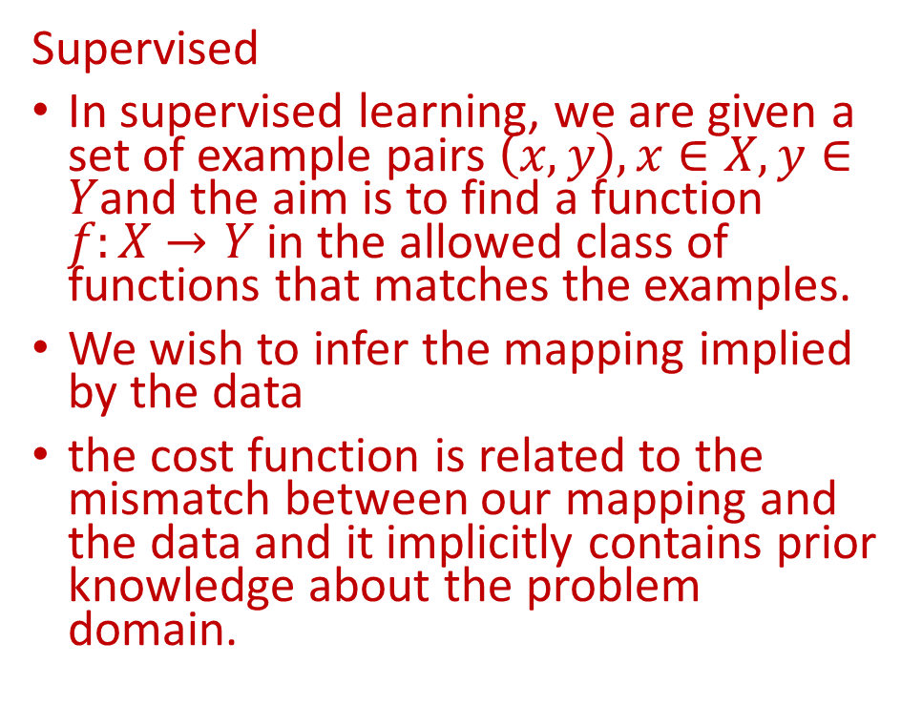
Learning Paradigms
Supervised
In supervised learning, we are given a set of example pairs $\left(x,y\right),x∈X,y∈Y$and the aim is to find a function $f:X→Y$ in the allowed class of functions that matches the examples.
We wish to infer the mapping implied by the data
the cost function is related to the mismatch between our mapping and the data and it implicitly contains prior knowledge about the problem domain.
Unsupervised learning
In unsupervised learning, some data $x$ is given and the cost function to be minimized, that can be any function of the data $x$ and the network’s output, $f$.
The cost function is dependent on the task (what we are trying to model) and our a priori assumptions (the implicit properties of our model, its parameters and the observed variables).

Slide 7
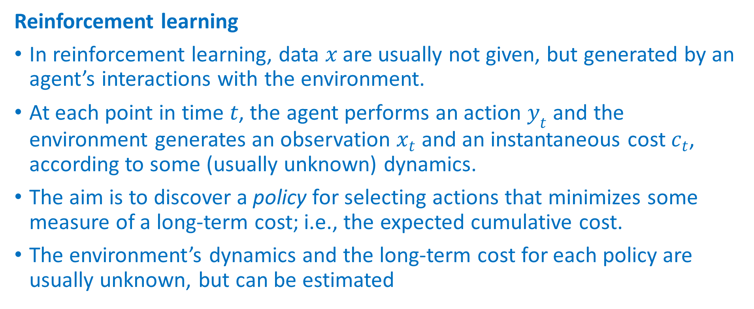
Learning Paradigms
Reinforcement learning
In reinforcement learning, data $x$ are usually not given, but generated by an agent’s interactions with the environment.
At each point in time $t$, the agent performs an action $y_{t}$ and the environment generates an observation $x_{t}$ and an instantaneous cost $c_{t}$, according to some (usually unknown) dynamics.
The aim is to discover a policy for selecting actions that minimizes some measure of a long-term cost; i.e., the expected cumulative cost.
The environment’s dynamics and the long-term cost for each policy are usually unknown, but can be estimated

Slide 8
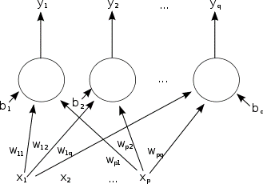
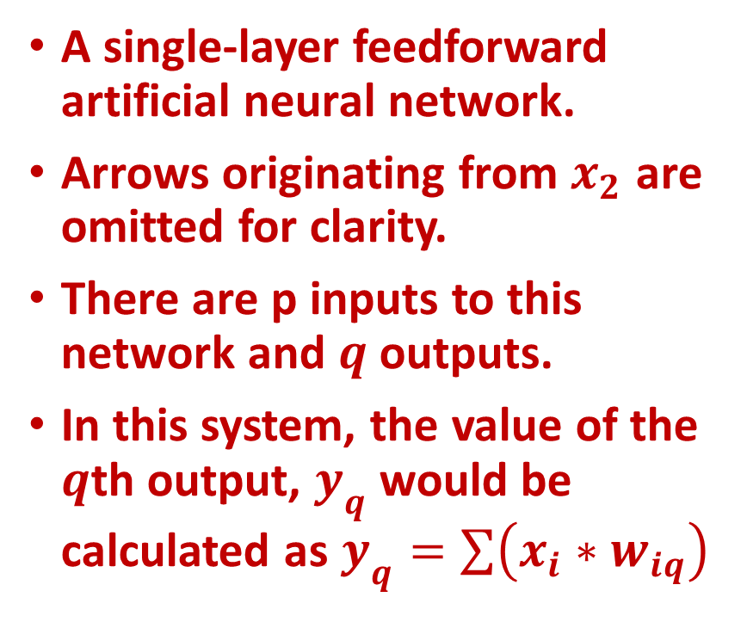
Types of artificial neural networks
A single-layer feedforward artificial neural network.
Arrows originating from $x_{2}$ are omitted for clarity.
There are p inputs to this network and $q$ outputs.
In this system, the value of the $q$th output, $y_{q}$ would be calculated as $y_{q}=\sum{\left(x_{i}∗w_{iq}\right)}$

Slide 9
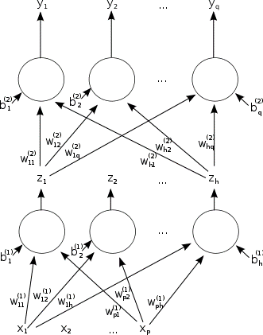
Types of artificial neural networks
A two-layer feedforward artificial neural network

Slide 10
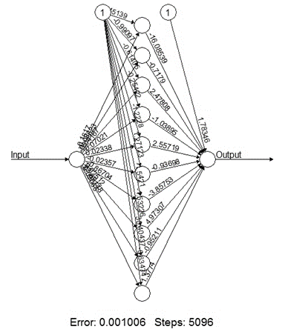
Neual Network - Example
In this example a neural network (or Multilayer perceptron depending on naming convention) will be build that is able to take a number and calculate the square root (or as close to as possible).
The R library ‘neuralnet’ will be used to train and build the neural network.

Slide 11
Input Expected Output Neural Net Output
Input Expected Output Neural Net Output
1 1 0.9623402772
4 2 2.0083461217
9 3 2.9958221776
16 4 4.0009548085
25 5 5.0028838579
36 6 5.9975810435
49 7 6.9968278722
64 8 8.0070028670
81 9 9.0019220736
100 10 9.9222007864

Slide 12
Set Up Training and Model
traininginput <- as.data.frame(runif(50, min=0, max=100))
trainingoutput <- sqrt(traininginput)
trainingdata <- cbind(traininginput,trainingoutput)
colnames(trainingdata) <- c("Input","Output")
net.sqrt <- neuralnet(Output~Input,trainingdata, hidden=10, threshold=0.01)
print(net.sqrt)
Call: neuralnet(formula = Output ~ Input, data = trainingdata, hidden = 10, threshold = 0.01)
1 repetition was calculated.
Error Reached Threshold Steps
1 0.001255130578 0.007678187336 3699

Slide 13
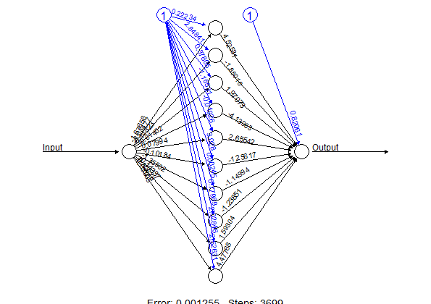
Plot the AAN
plot(net.sqrt)

Slide 14
Set Up Test Data
testdata <- as.data.frame((1:10)^2)
ls(net.sqrt)
[1] "act.fct" "call" "covariate"
[4] "data" "err.fct" "generalized.weights"
[7] "linear.output" "model.list" "net.result"
[10] "response" "result.matrix" "startweights"
[13] "weights"

Slide 15
Preint Results
print(net.sqrt$net.result)
[[1]]
[,1]
1 6.833312439
2 9.807364135
3 7.221685960
4 6.753280677
5 5.826920952
6 6.684443060
48 6.156065762
49 7.183283465
50 4.646702010

Slide 16
Print predicted vales
cleanoutput <- cbind(testdata,sqrt(testdata), as.data.frame(net.results$net.result))
colnames(cleanoutput) <- c(“Input”,”Expected Output”,”Neural Net Output”)
print(cleanoutput)
(1:10)^2 (1:10)^2 structure.c.6.83331243930511..9.80736413512019..7.22168595978613..
1 1 1 6.833312439
2 4 2 9.807364135
3 9 3 7.221685960
4 16 4 6.753280677
5 25 5 5.826920952
49 81 9 7.183283465
50 100 10 4.646702010

Slide 17
Loose Ends – Text Analytics with koRpus
library(koRpus)
library(tm)
library(NLP)
tagged.text <- tokenize("C:/Users/Strickland/Documents/VIT University/Data_Analytics.txt", lang="en")
taggedText(tagged.text)
head(taggedText(tagged.text),n=20)
token tag lemma lttr wclass
1 Predictive word.kRp 10 word
2 analytics word.kRp 9 word
3 — -kRp 1 punctuation
4 sometimes word.kRp 9 word
5 used word.kRp 4 word
6 synonymously word.kRp 12 word
7 with word.kRp 4 word
8 predictive word.kRp 10 word
9 modeling word.kRp 8 word
10 — -kRp 1 punctuation
… … … … …
15 statistics word.kRp 10 word

Slide 18
www.humalytica.com
http://www.amazon.com/Jeffrey-Strickland/e/B00IQ69QZK/
http://www.lulu.com/spotlight/strickland_jeffrey

